Slide 1



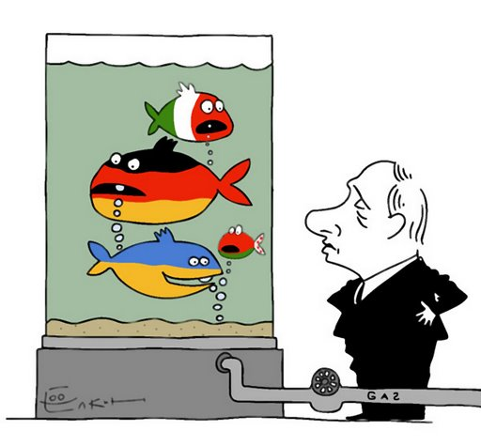
EUROPE UNDER GAS ATTACK
Analysis of possible scenarios
Andrii Chubyk
CSF WG3 Energy analyst
http://www.allrussias.com/essays/hobley_diss_17.asp
23 October 2014

Slide 2

Gas stress-tests
First all-European study aims at assessing in detail the impact of a potential disruption of gas supplies in various European countries and at developing lessons on how to minimize the potential negative impact.
How did it work?
Simulation security of supply situation in the different scenarios.
What are the main findings?
Full-scale gas supply to Europe cut off and Ukrainian transit route blockade as two main scenarios with period from 1 to 6 moths.
Only cooperative approach among all European countries could significantly reduce the impact of possible gas shortages.
Market-based approach should be the guiding principle, with non-market measures (i.e. the release of strategic stocks, forced fuels switching and demand curtailment) only kicking in when the market fails.
http://europa.eu/rapid/press-release_MEMO-14-593_en.htm
nomos.com.ua | geostrategy.org.ua
№ стр.2

Slide 3
Proposed short term measures
  Countries should follow a market-based approach and avoid interventionist measures;
  countries should increase energy coordination with each other including through the maximisation of interconnector capacity and removal of restrictions to cross-border energy trade;
  responsibility should be shared between public authorities and industry through the implementation of the EU's Security of Gas Regulation;
  short-term behavioral changes should be enacted to boost energy efficiency and lower demand;
  the EU's Gas Coordination Group should continuously monitor developments in the gas supply
  http://ec.europa.eu/energy/stress_tests_en.htm
  Challenging tasks for EU member states with mostly national interests as the main priority in terms of energy policy (examples – SK-HU interconnector, HU-UA reverse supply).
nomos.com.ua | geostrategy.org.ua
№ стр.3

Slide 4
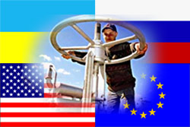
Open questions
  What is the mechanism to ensure interstate cooperation in case of emergency by gas supply shortages?
  How to preserve market based approach by state controlled companies, in particular, in CEE countries?
  How to make incentives for behavioral changes?
  How to empower the EU's Gas Coordination Group?
  How to ensure proper business conditions for gas owners in UGSF?
http://crisis-blog.ru/russia-ukraine/itogi-gazovoj-vojny-kto-vinovat-kto-pobedil.html
nomos.com.ua | geostrategy.org.ua
№ стр.4

Slide 5
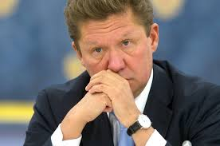
Proposed solution
The EU together with non-EU Energy Community member states should conduct practical emergency exercises to check gas stress-test findings and recommendations.
  Announce to member states preliminary term and duration;
  Suggest to prepare national emergency plans and cooperation agreements with neighbors;
  Official notifications to Gazprom and Russian government;
  Develop a test task on the level of European Commission;
  Practical implementation.
http://uainfo.org/blognews/341346-kak-gazprom-reshit-problemu-s-dyroy-v-byudzhete-iz-za-poteri-ukrainskogo-rynka.html
Gazprom will lose initiative and react retroactively, it is not used to do;
EU companies will sell gas and avoid critical financial losses in spring 2015
nomos.com.ua | geostrategy.org.ua
№ стр.5

Slide 6
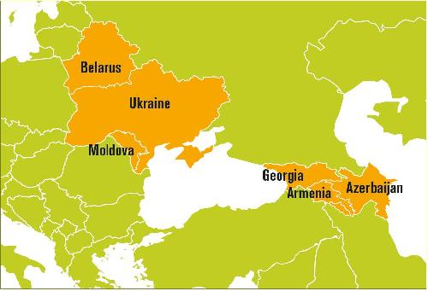
Involvement of EaP countries
Ukraine is a key subject of influence and most important player in expected gas tensions in Europe
Gas sector under Russia control
Subjects of possible Russian anti-gas sabotage actions
Under threat of gas cut off
Gas sector under Russia control
http://www.enpi-info.eu/eastportal/news/latest/36834/EU-support-for-Green-Economies-and-sustainable-consumption:-EaP-GREEN-workshop-in-Tbilisi
nomos.com.ua | geostrategy.org.ua
№ стр.6

Slide 7
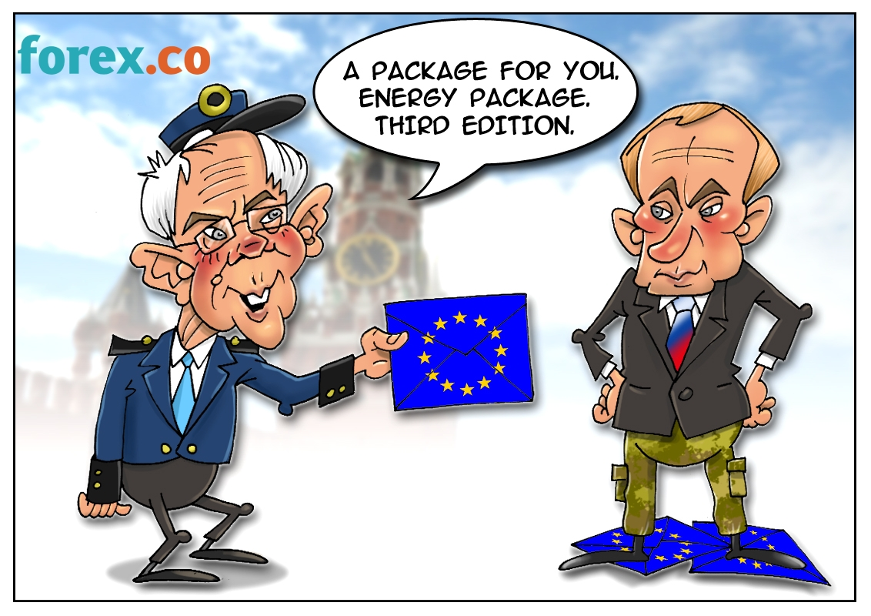
Recommendations (Russia)
  Strong commitments to “Third Energy Package” unbundling requirements with regard to Russian energy projects (Nord and South stream);
  Requirement on Russia to demonopolize energy market, ensure access to energy infrastructure for third parties, including Central Asia and Caucasus countries;
  Access for EU's Gas Coordination Group to transborder gas metering stations on Russian territory;
  Development of a multilateral early warning mechanism with online metering of the chain “supply-transit-consumption”.
http://www.forex.co/forex_humor/view/8306
nomos.com.ua | geostrategy.org.ua
№ стр. 7

Slide 8

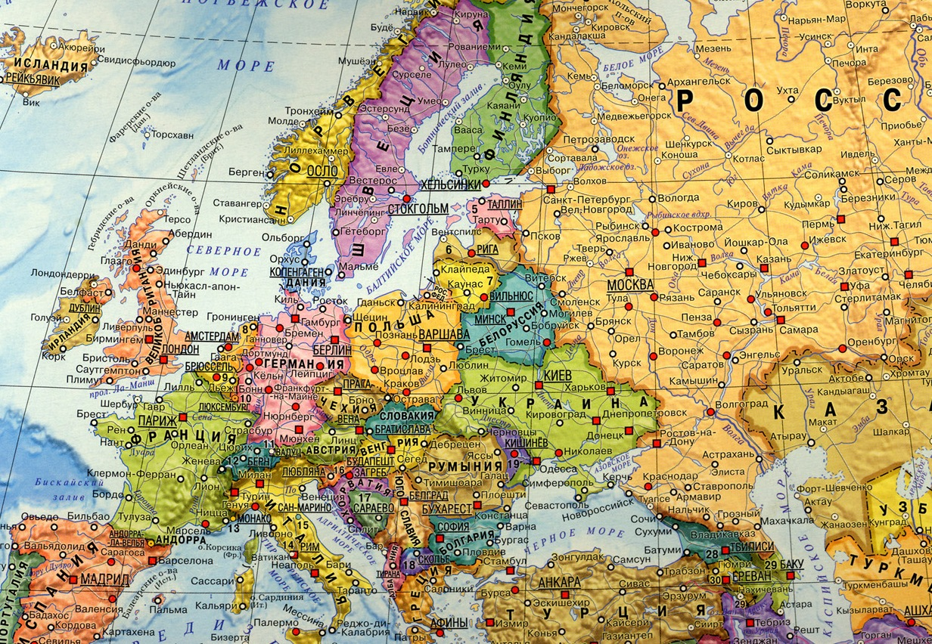
Scheme of the Transparency Regime for Trans-border Gas Flows
as an Early Warning Mechanism
1. WORKING PRESSURE
2. INCOMING / OUTCOMING
VOLUMES (DAYLY)
Exporter
(RU)
on-line verification
Importer
(EU)
Transmitters
EaP countries (UA, BY, MD)
nomos.com.ua | geostrategy.org.ua
№ стр. 8

Slide 9
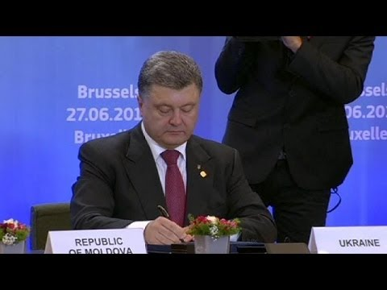
Recommendations (Ukraine and other Energy Community members)
  Acceleration of unbundling procedures in energy sector;
  Strong commitments toward energy efficiency measures;
  Regular information on energy production, transportation and consumption;
  Gradual introduction of market based pricing for gas, electricity and heat;
  Change of gas delivery point for gas to the borders of Energy Community Treaty signatories;
  Transparent tariff setting and access to UGSF for EU companies.
http://tsn.ua/politika/ukrayina-pidpisala-ekonomichnu-chastini-ugodi-pro-asociaciyu-z-yes-356567.html
nomos.com.ua | geostrategy.org.ua
№ стр.9

Slide 10


Center NOMOS
Centre for Global Studies “Strategy XXI”
THANK YOU FOR YOUR ATTENTION!
CONTACTS:
www.geostrategy.org.ua
a.geostrategy@gmail.com
T. +380 44 5070198.

