Slide 1


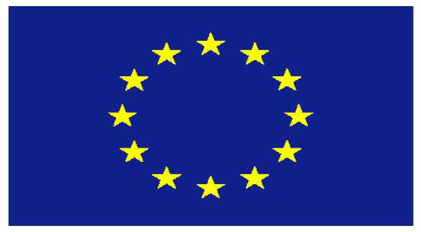
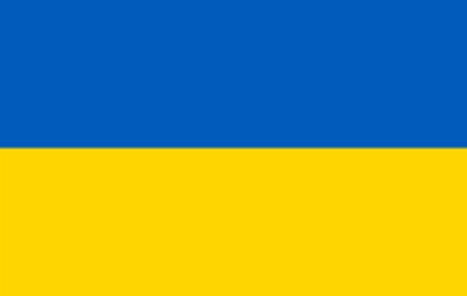


Ukraine, Energy Community and the EU: expectations and results
MYKHAILO GONCHAR
NOMOS / Strategy XXI
Ukraine
Tbilisi, February 20, 2014

Slide 2
Ukraine, Energy Community and the EU: expectations and results. Some conclusions for the EU-oriented countries
Energy Community: expectations and realities
Ukraine in the ECT: unsuccessfully story
European single voice and ECT
Russian challenge for ECT and EU
Lack of solidarity and consequences
Ukrainian “Dark area” and Russian non-transit project
Risks for gas transit through S. Caucasus

Slide 3
Energy Community: expectations and realities
Signatory to the Energy Community Treaty makes you closer to the EU but it definitely does not open the way to the EU membership perspective.
The ECT is a tool of influence of the EC on ECT signatories, but it will not become your tool of influence on Brussels.
The ECT is the mechanism for the EU energy legislation implementation into the legislative, regulatory and legal framework.
Successful implementation of the European energy legislation will have some positive impact on investment attractiveness of your energy sector for EU investors.

Slide 4
Ukraine in the ECT: unsuccessfully story
Since February 1, 2011, Ukraine has been the signatory to the Treaty
There are several reasons, why Ukraine’s membership is not a successful one, at least during the last three years:
Real priorities of GoU were concentrated on relations with Gazprom, which was and is vexed with the ECT.
The GoU had populism view on Ukraine’s European integration, energy sector reforms were simulated and did not bring any qualitative changes.
Russia made all and very efforts to hamper closer relations between the EU and Ukraine, in particular in energy sector. It requested twice Ukraine’s withdrawal from the ECT.
During three years of membership, Ukraine warned twice about withdraw from the Treaty.

Slide 5
European single voice and ECT
The very first is a lack of the EU single voice, announced back in 2007.
lack of consensus regarding EU perspectives for several neighboring countries, which are participants of the Eastern Partnership and important partners for the EU in terms of energy communication
ECT expansion to the Eastern Europe without a simultaneous solution of the question about European membership perspective for ECT and EaP countries creates huge problems for promotion of European rules of play in energy sector.

Slide 6
Russian challenge for ECT and EU
Russia defied the EU, striving not only to prevent the spread of the European rules in the post-Soviet space, but also to affect Brussels to revise some of the key provisions of the EU energy legislation, such as the Third Energy Package.
EU faces a choice: to promote European principles of the energy markets functioning or to support the relations with Russia and it prefers the second.
Russia prefers bilateral relations with EU members where Moscow has stronger position.

Slide 7
Lack of solidarity and consequences
A real thing that Energy Community lacks is the solidarity mechanism in the case of the third party actions against one or several member states of the Treaty.
Russian project South Stream, bypassing Ukraine, Moldova, Romania, is directed to deprive this countries of their transit function of gas supply to the EU and to cause the economic damages.
Do not be surprised if some time after the accession of Georgia to the ECT, Russia will demand you to give access for Gazprom to your pipelines, basing its claim on the EU Third Energy Package.

Slide 8
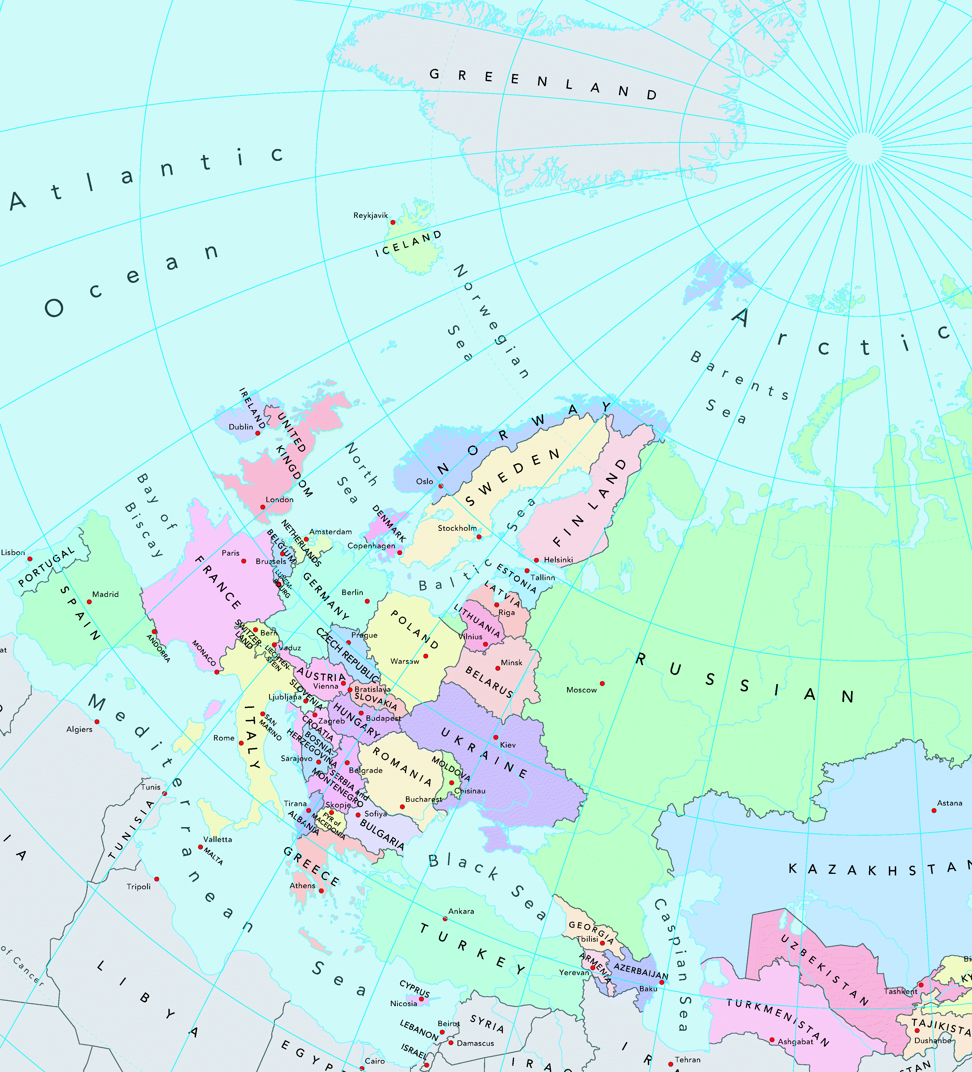
“Dark areas” and energy and transit sensitive areas with potential of non-military and military tensions
Arctic area: shelf
Eastern Europe: unconventional gas
Black Sea: shelf
Caspian Sea & Southern Caucasus: transit C.Asian and Azeri gas
E. Mediterranean: shelf
Syria: potential transit for different gas flows

Slide 9


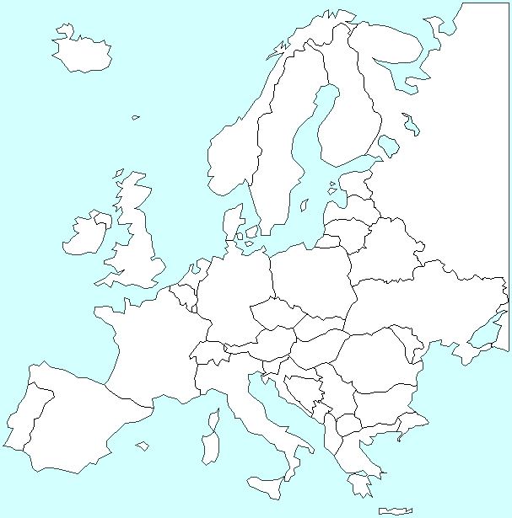

Ukraine and Poland are the future Methane Belt of Europe: potential of unconventional gas extraction, 2030. The end of ‘Gazprom age’ in the Central & Eastern Europe
∑= 59÷155 bcma
(2030)
PL
UA
Existing level: ∑=~25 bcma
(2012)

Slide 10
“Dark areas” and Russian non-transit project
Nabucco became a symbol of collapse of the EU external energy policy.
The EU gas market is becoming more competitive thanks to LNG.
Gas flows from the Caspian Sea and potential gas from Central Asia are competitive to traditional gas flow from Siberia.
Russia is implementing a large-scale economically senseless pipeline project "South Stream" to bring gas from Siberia and Yamal to Southern Europe.

Slide 11
Risks for gas transit through S.Caucasus
Now, in order to finally reach an agreement with the EU on South Stream, Russia demonstrates to Brussels once again the need of bypassing Ukraine. Transformation of Ukraine into the "dark zone" fits best as "convincing argument" for Brussels.
Now, if to make an extrapolation to the S. Caucasus and consider that Gazprom does not need a competitive gas from the Caspian Sea, it is possible to conclude that the destabilization scenario can be expected.
According to the logic of the Kremlin, it should be another argument for Europe in the benefit of the "stable" gas supplies from Russia via the no transit direct "South Stream" compared with supplies from the unstable Caspian region through the unstable S. Caucasus.

Slide 12
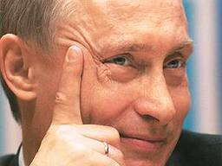
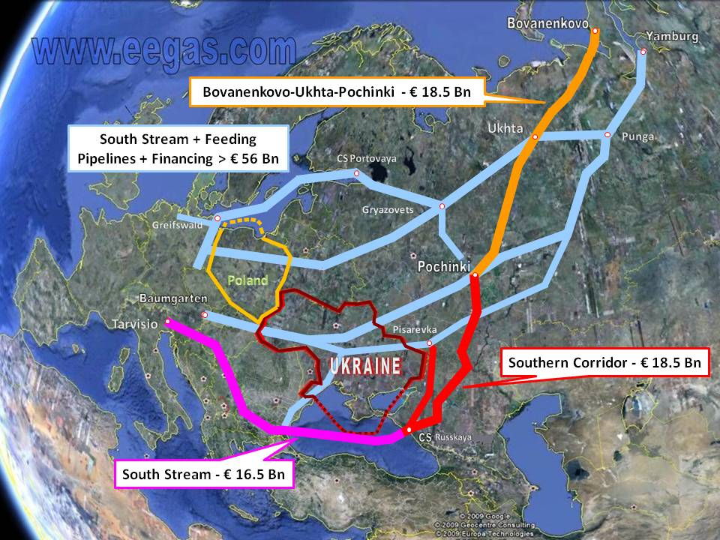
Russian achievements: fall of Nabucco + resistance to TransCaspian Gas Pipeline + acceleration of South Stream (first line)
Calculation of minimal level for “kickback money” from South Stream:
Total budget
€56.0 bln
x 22% =
€12.3 bln
nomos.com.ua | geostrategy.org.ua

Slide 13
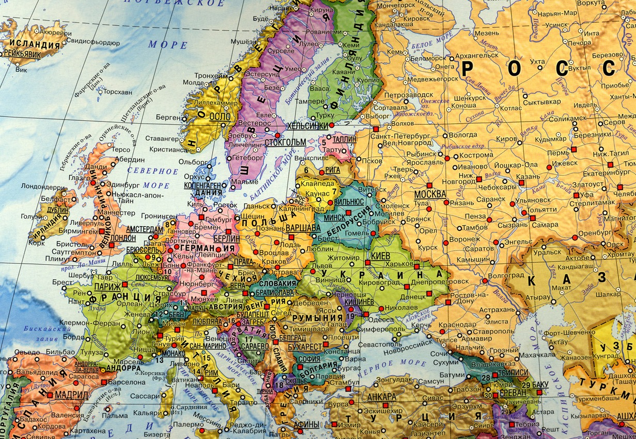
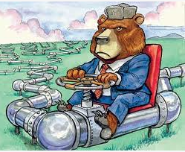
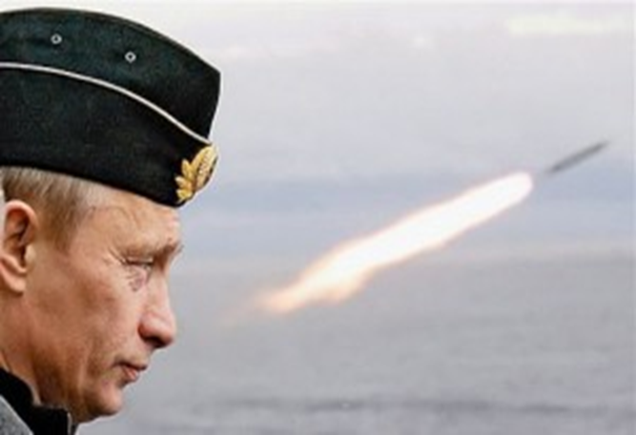

The scheme of future gas streams
according to Russian dreams
NORD STREAM
YAMAL-EUROPE
MAINSTREAM.UA
Hub Baumgarten
SOUTH STREAM
TANAP

Slide 14

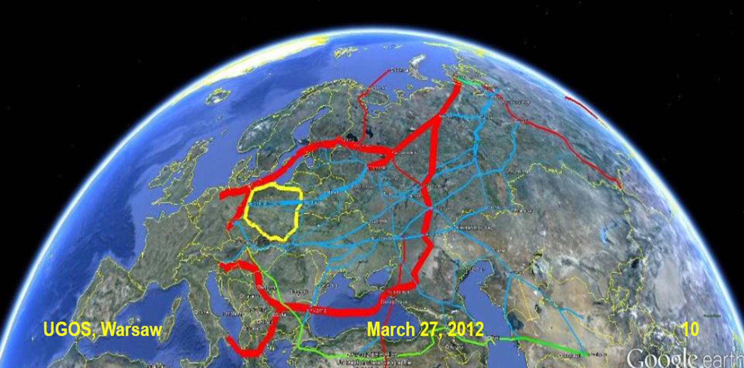


Scenario «Dark areas» aimed to keep Russian gas monopoly of supply to the EU through the Eastern Gas Corridor and create no alternative for Russian bypass streams

Slide 15
General conclusion: Georgia needs Energy Community membership but the membership in NATO is extremely important to provide security for Georgia

Slide 16



NOMOS
Centre for Global Studies “Strategy XXI”
www.nomos.com.ua
geostrategy.org.ua
mi.gor17@gmail.com

